Slide 1

UNIT-I: LASERS
Dr.A.Sivakami,
Associate Professor,
Department of Physics,
Malla Reddy University, Hyderabad.

Slide 2
Different LASER LEVEL schemes Three and Four levels
Three level pumping schemes
It operates in pulse mode. Ex. Ruby Laser

Slide 3
Four level pumping scheme-operates in continuous wave mode Ex. Helium-neon laser & Co2 Laser

Slide 4
Types of laser based on MEDIUM
Most lasers emit light in the red or IR regions. Laser work in continuous mode or in a pulsed mode.

Slide 5
Types of laser based on MEDIUM
Based on the type of active medium, Laser systems are broadly classified into the following categories.
S.No. | Type of laser | Examples
1. | Solid state laser | Ruby Laser Nd:YAG laser etc.
2. | Gas Laser | He-Ne Laser, CO2 Laser etc.
3. | Liquid laser | Europium Chelate Laser etc.
4. | Dye Laser | Rhodamine 6G laser, Coumarin dye laser etc.
5. | Semiconductor diode laser | GaAs laser, InP, GaAsP laser etc.

Slide 6
Construction and working of LASER: Subheadings
Principle
Construction-Experimental Set up
Working- Energy level diagram
Characteristics- Type, Pumping source & method, active medium, active centre, optical resonator, Nature of light , Power of output, Output wavelength of laser
Advantages
Disadvantages
Applications

Slide 7
RUBY LASER
PRINCIPLE
It belongs to three level solid-state laser. Ruby rod is basically 0.05% Cr³⁺ ions doped with Al₂O₃ crystal material used as active medium or laser medium. It was designed by T.H.Maiman in the year 1960. It is the first visible laser light emitted with wavelength of deep red colour 6943Å or 694.3 nm

Slide 8
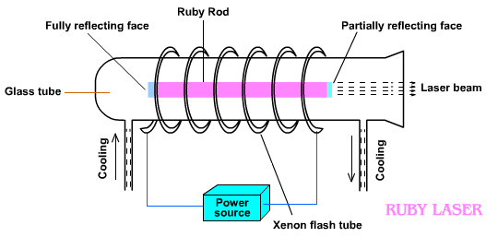
CONSTRUCTION

Slide 9
WORKING

Slide 10
Initially Cr 3+ions are the ground state E1.When Xenon flash lamp (white)switched on
Cr 3+ ions in the excited state (E3)
Absorb green and blue wavelength 5600Å, 4500Å
After certain time Cr 3+ ions are falling to the level E2 (meta stable sate) by a non-radiative transition.
Continuous pumping helps the accumulation of Cr 3+ ions in the level E2 which gives population inversion between E2 & E1.
The emitted photons of red wavelength 6943Å reflected by the both mirrors and amplified. It emerged out of the semi transparent or 50% reflecting mirror in the form of strong beam

Slide 11
CHARATCERISTICS of RUBY laser
1. Type: Solid State Laser
2. Active Medium: Al2O3: Cr 3+ ions
Active centre: Cr^3+ ions
3. Pumping method: Optical pumping
4. Pumping source: Xenon flash lamp
5. Optical resonator: Two ends of ruby rod polished with silver used as optical resonator. (one end is fully silvered & other mirror partially silvered)
6. Power Output: 10^4 -10^6 watts (high power output)
7. Nature of output: Pulsed light
8. Output Wavelength: 6943Å or 694.3 nm

Slide 12
Advantages , Disadvantages & Applications
Advantages
Its output intensity is high
It has high acceptance band

Slide 13
Advantages , Disadvantages & Applications
Disadvantages
The efficiency of ruby laser is very low because only green component of the pumping light is used while the rest of components are left unused.
The laser output is not continuous but occurs in the form of pulses of microseconds duration.
The defects due to crystalline imperfection are also present in this laser

Slide 14
Applications
Applications
1.Many non-destructive testing labs use ruby lasers to create holograms of large objects such as aircraft tires to look for weaknesses in the lining
2. It is used to find distance between planets
3. Ruby lasers were used extensively in tattoo and hair removal

Slide 15
Helium-Neon Laser
He-Ne Laser
Principle:
The He-Ne laser active medium consists of two gases which do not interact form a molecule. Therefore He-Ne laser is one type of atomic gas laser and also called as Four level laser.
2. CONSTRUCTION
In 1960 Ali Javan, W.Bennett & D.Herriot invented the first gas laser that was the Helium-Neon laser. It was the first continuous-light laser and first to operate on the principle of converting electrical energy to a laser light output.

Slide 16
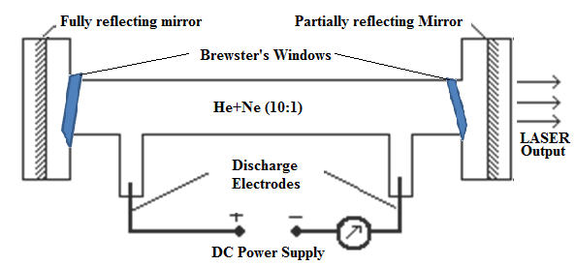
Helium-Neon Laser

Slide 17
He - Ne gas laser consists of a gas discharge tube of length 30cm and diameter of 1.5cm. The tube is made up of quartz and is filled with a mixture of Neon under a pressure of 0.1mm of Hg. The Helium under the pressure of 1mm of Hg, the ratio of He-Ne mixture of about 10:1, hence the no. of helium atoms is greater than neon atoms. The mixtures is enclosed between a set of parallel mirrors forming a resonating cavity, one of the mirrors is completely reflecting and the other partially reflecting in order to amplify the output laser beam. The output of the laser depends upon the length of the discharge tube and the pressure of the gas mixture.

Slide 18
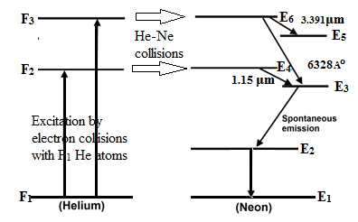
WORKING

Slide 19
In the He-Ne laser the light produced by atomic transitions within the Neon atom. The Helium does not directly produce laser light but it acts as a buffer gas, this purpose of which is to assist/help the atoms of the other gas to produce lasing action. The excited helium atom returns to the ground state by transferring its excess energy to a neon atom through collision by resonant energy transfer.
The active energy levels of He and Neon atoms are show in adjacent figure. In helium there are three active energy levels named as F₁, F₂ and F₃ (He1, He2 & He3)where as in Neon, there are six active energy levels named as (Ne1, Ne2, Ne3, Ne4, Ne5 & Ne6) E₁, E_{2,} E₃, E_{4,} E_{5,} and E_{6 .} In Helium, the metastable states are F₂ and F₃, where as in Neon, E₄ and E₆. The possible stimulated emissions are

Slide 20
E6 → E3 gives a laser light of wave length 6328Aº (or)
E6 →E5 gives a laser light wavelength of 3.39μm. (or)
Ne₆ Ne₅ transition: During this transition electromagnetic radiation of wave length 3.39 μm or 33900 Å
E4→E3 gives a laser light wavelength of 1.15μm. (or)
Ne₆ Ne₃ Transition: This transition generates a laser beam of red colour of wavelength 632.8 nm or 6328 Å
Ne₄ Ne₃ transition: During this transition electromagnetic radiation of wave length 1.15 μm or 11500 Å is emitted.

Slide 21
CHARATCERISTICS of Helium-Neon laser
1. Type: Gas Laser
2. Active Medium: Helium-Neon gases mixture
Active centre: Ne ions
3. Pumping method: Electrical discharge
4. Pumping source: R.F. Oscillator (DC Power supply)
5. Optical resonator: External setup mirror
6. Power Output: 5-50 milliwatts (high power output)
7. Nature of output: Continuous wave mode
8. Output Wavelength: visible and infrared wavelength (638.2 nm, 3.39 μm & 1.15 μm)

Slide 22
Advantages
1.Helium-neon laser emits laser light in the visible portion of the spectrum.
2.High stability
3.Low cost
4.Operates without damage at higher temperatures
Disadvantages
1.Low efficiency
2.Low gain
3.Helium-neon lasers are limited to low power tasks

Slide 23
Applications
Helium-neon lasers are used in industries.
Helium-neon lasers are used in scientific instruments.
Helium-neon lasers are used in the college laboratories.
The He-Ne Laser is used in Holography in producing the 3D images of objects.

Slide 24
Semiconductor diode laser
Laser action can also be produced semiconductors. The most compact of all the lasers in semiconductor diode laser and it is unique. It is also called injection laser. It is invented by R N Hall and coworkers in USA, 1962.
The main principle of working of the semiconductor laser is RECOMBINATION. The electron–hole pair is the fundamental unit of generation and recombination in semiconductors and optoelectronic devices.
Types of Semiconductor diode laser
There are two types of semiconductor diode lasers.
i. Homo junction laser
ii. Hetero- Junction laser.

Slide 25
Semiconductor diode laser
Homo – Junction laser:
If a p-n junction is formed in a single crystalline material, then it is called as homo-junction laser. It is formed between n-type and p-type semiconductor of same material
Example: single crystal of gallium Arsenide (Ga-As).
Hetero- Junction laser:
If p-n junction is formed with different semiconducting materials, then it is known as Hetero- Junction laser. It is formed n-type and p-type semiconductors of different materials. It is also called modern laser diode.
Example: Hetero- Junction laser can be formed between Ga-As and Ga-Al-As.

Slide 26
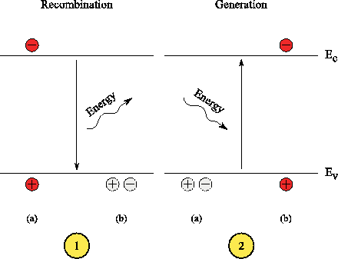
Carrier Recombination and carrier generation in semiconductors

Slide 28
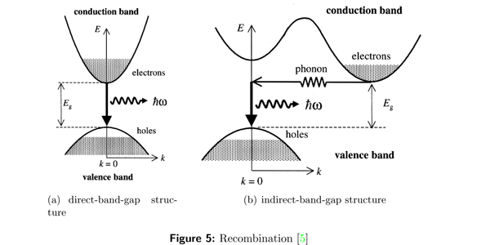
DIRECT & Indirect bandgap semiconductors

Slide 29
Direct band gap Semiconductor:
In this type, during the recombination of hole and electron, a photon of light is released.
Example: Ga-As
In direct band gap Semiconductor:
In this type, heat energy is produced during the recombination of hole and electron.
Example: Germanium and silicon.

Slide 30
Homojunction laser
Principle:
When a p-n junction diode is forward biased, the electrons from n – region and the holes from the p- region cross the junction and recombine with each other.
During the recombination process, the light radiation (photons) is released from a certain specified direct band gap semiconductors like Ga-As. This light radiation is known as recombination radiation.
The photon emitted during recombination stimulates other electrons and holes to recombine. As a result, stimulated emission takes place which produces laser.

Slide 31
Construction of homojunction semiconductor diode laser

Slide 32
In this laser system, the active medium is pn junction diode formed between n-GaAs and p-GaAs. The impurities germanium and tellurium are doped into GaAs semiconductor to obtain p-type and n-type GaAs respectively. The thickness of the pn-junction layer is very narrow so that the emitted radiation has large divergence and poor coherence. At the junction two sides which are parallel to each other and are well polished through which laser is emitted and other sides are roughened to avoid laser emission. To provide forward bias two metal contacts are provided in the top and bottom of the diode. This diode is extremely small in size i.e 500 μm long and 100 μm wide and thick.

Slide 33
In heavily doped semiconductors, recombination rate is very fast because of large number of charge carriers

Slide 34
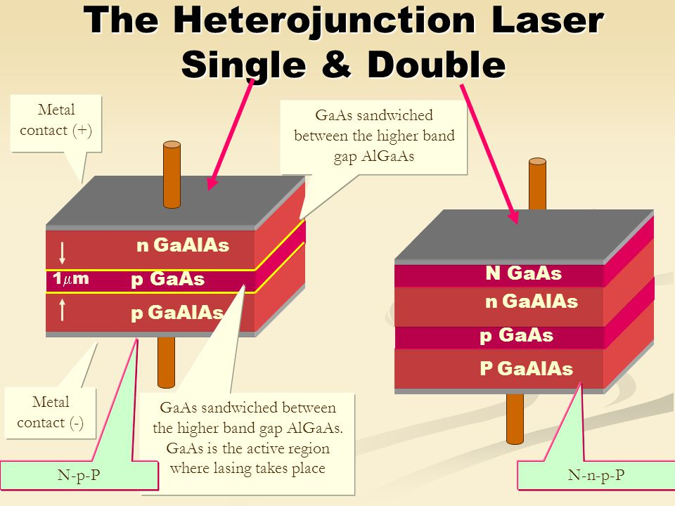
Construction of heterojunction semiconductor diode laser

Slide 35
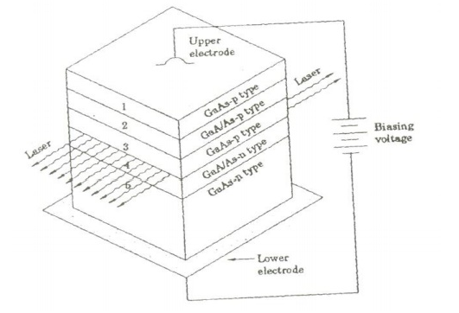
Construction of heterojunction semiconductor diode laser

Slide 36
construction
The heterojunction diode laser further classified as single and double heterojunction laser diode lasers. It is a multilayer structures designed such that the carriers are confined in a narrow region and population built up at lower current levels.
We study here the structure and working of a double heterojunction diode laser. In a double heterojunction laser, a GaAs layer is sandwiched between two layers of GaAlAs.
The material GaAlAs has a wider energy gap and a lower refractive index than GaAs. In figure, the numbers 1,2,3,4 and 5 are indicating the various layers. The laser emission takes place between the layers 2 and 4 where 1,2,4 are GaAlAs layers and 3,5 are GaAs layers.

Slide 37
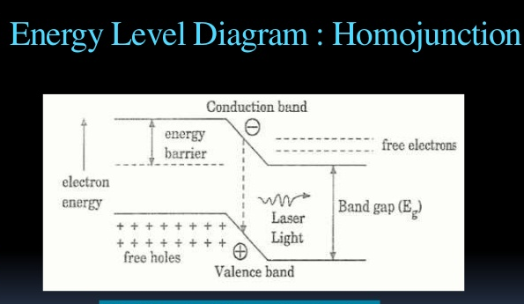
Working of both homojunction and heterojunction diode laser

Slide 38
The working principle is same for the homo and heterojunction diode laser systems. The population inversion can be obtained by injecting electrons and holes in to the junction from the n-region and p-region by means of forward bias voltage.
When the forward bias is not connected, no electrons and holes present in the depletion region. When small forward bias voltage is given to the p-n junction then small number of electrons and holes will injected into the depletion region from respective regions.

Slide 39
When relatively a large current of the order of 10⁴ A/cm² is passed through the junction then large number of electrons and holes will be injected into the depletion region as shown in above figure. Then the direct recombination processes take place between holes and electrons in the depletion region and release the photons. Further the emitted photons increase the rate of recombination. Thus more number of photons produced having same phase and frequency of the induced photons.

Slide 40
The wavelength of the emitted radiation depends on the energy band gap of the semiconductor material. The energy gap of the GaAs Semiconductor is 1.44 eV then it emits laser light of wavelength ~8600 Aº
The wavelength of laser light is given by,
h=6.626 x 10 ^-34 J.S
C= 3 x 10^8 m/s
Eg=1.45 eV for GaAs or joule then wavelength of laser light can be calculated.

Slide 41
CHARACTERISTICS OF HOMOJUNCTION DIODE LASER
1. Type: Solid state semiconductor Laser
2. Active Medium:
A PN junction diode made from single crystal of gallium arsenide is used as an active medium.
Active centre: pn junction
3. Pumping method: Direct Conversion
4. Pumping source: High forward bias voltage supplied battery
5. Optical resonator: p-n junctions are polished well act as a optical resonator
6. Power Output: 1 milliwatts
7. Nature of output: Continuous wave mode or pulsed
8. Output Wavelength: 8300 to 8500 Å

Slide 42
CHARACTERISTICS OF HETEROJUNCTION DIODE LASER
1. Type: Solid state semiconductor Laser
2. Active Medium:
A PN junction diode made from different layers is used as an active medium.
3. Pumping method: Direct Conversion
4. Pumping source: High forward bias voltage supplied battery
5. Optical resonator: p-n junctions are polished well act as a optical resonator
6. Power Output: 1 milliwatts
7. Nature of output: Continuous wave mode or pulsed
8. Output Wavelength: Nearly 8000 Å

Slide 43
Advantages of Homojunction diode laser
1.It is very small in dimension. The arrangement is simple and compact.
2. It exhibits high efficiency.
3. The laser output can be easily increased by controlling the junction current
4. It is operated with lesser power than ruby and CO2 laser.
5. It can have a continuous wave output or pulsed output

Slide 44
Disadvantages of Homojunction diode laser
1. It is difficult to control the mode pattern and mode structure of laser.
2. The output is usually from 5 degree to 15 degree i.e., laser beam has large divergence.
3. The purity and monochromacity are power than other types of laser
4. Threshold current density is very large (400A/mm^2).
5. It has poor coherence and poor stability.

Slide 45
Applications
1. It is widely used in fiber optic communication
2. It is used to heal the wounds by infrared radiation
3. It is also used as a pain killer
4. It is used in laser printers and CD writing and reading.

Slide 46
Advantages of heterojunction diode laser
1. It produces continuous wave output.
2. The power output is very high.
Disadvantages
1. It is very difficult to grow different layers of PN junction.
2. The cost is very high.
Applications
1.This type of laser is mostly used in optical applications
2. It is widely used in computers, especially on CD-ROMs.

Slide 47
Comparison chart of different types of lasers
S.No. | Characteristics | RUBY LASER | He-Ne Laser | Semiconductor diode laser
1. | Type | Solid laser | Gas laser | Semiconductor laser
2. | Active Medium | Al₂O₃: Cr³⁺ ions | 10:1 ratio of He-Ne gas mixture | p-n Junction
3. | Active Center | Cr³⁺ ions | Ne gas atoms | Single and Multiple layers of p-n junction
4. | Pumping Method | Optical pumping | Electric Discharge | Direct Conversion
5. | Pumping Source | Xenon Flash Lamp | Radio frequency Oscillator | A high voltage Battery
6. | Optical Resonator | Two ends of ruby rods are well polished | External set up mirror is established | One face of p and n semiconductors are polished
7. | Power Output | 10⁴ -10⁶ watts | 5-50 mW | 1 mW
8. | Nature of Output | Pulsed laser light | Continuous laser light | Either continuous or pulsed
9. | Wavelength of Output | 6943Å | 6328 Å | ≈8000-8500 Å

Slide 48
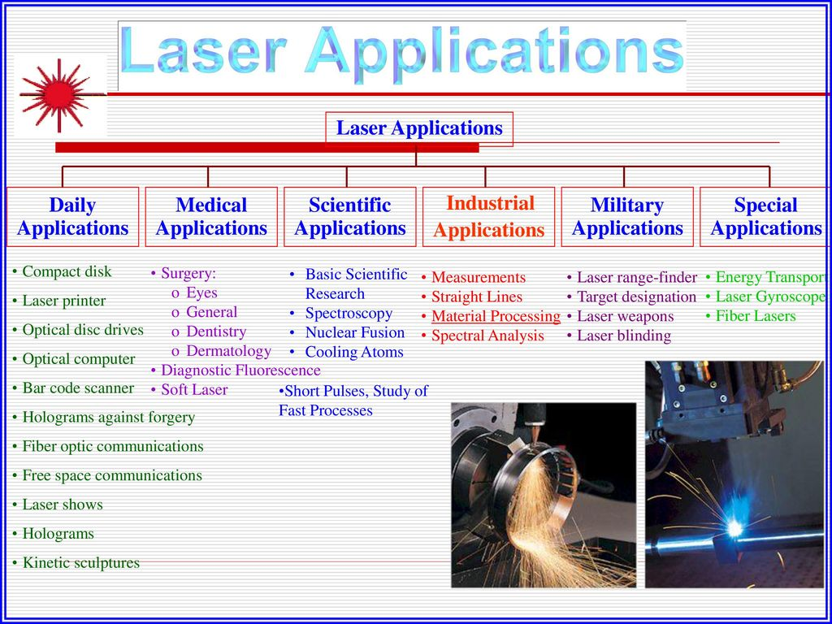

Slide 49
APPLICATIONS OF LASER IN INDUSTRY
The most significant applications of lasers include:
Lasers in medicine
Lasers in industries
Lasers in science and technology
Lasers in military
Lasers in IT [communications]

Slide 50
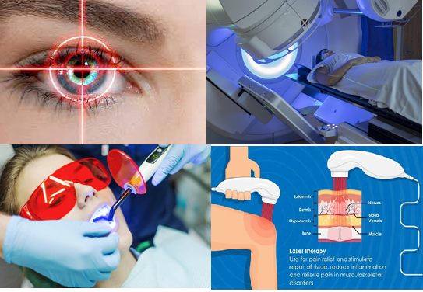
Lasers in Medicine

Slide 51
Lasers in Medicine
Lasers are used for bloodless surgery.
Lasers are used to destroy kidney stones.
Lasers are used in cancer diagnosis and therapy.
Lasers are used for eye lens curvature corrections.
Lasers are used in fiber-optic endoscope to detect ulcers in the intestines.
The liver and lung diseases could be treated by using lasers.
Lasers are used to study the internal structure of microorganisms and cells.
Lasers are used to produce chemical reactions.
Lasers are used to create plasma.

Slide 52
Lasers in Medicine
Lasers are used to remove tumors successfully.
Lasers are used to remove the caries or decayed portion of the teeth.
Lasers are used in cosmetic treatments such as acne treatment, cellulite and hair removal.

Slide 53
Types of Lasers in Medicine
The three types of lasers most often used in medical treatment are the:
Carbon dioxide (CO₂) laser. Primarily a surgical tool, this device converts light energy to heat strong enough to minimize bleeding, while cutting through or vaporizes tissue.
Neodymium: yttrium-aluminum-garnet (Nd:YAG) laser. Capable of penetrating tissue more deeply than other lasers, the Nd:YAG laser enables blood to clot quickly, allowing surgeons to see and can enable surgeons to see and touch body parts that could otherwise be reached only through open (invasive) surgery.
Argon laser. This laser provides the limited penetration needed for eye surgery and superficial skin disorders. In a special procedure known as photodynamic therapy (PDT), this laser uses light-sensitive dyes to shrink or dissolve tumors.

Slide 54
Laser Surgery
Different types of lasers are used for different types of surgeries. For example, a CO2 laser is used to make small cuts for making shallow cuts for treating superficial cancers like skin cancer. Nd: YAG lasers are to treat throat cancers. They can penetrate deeper into the tissues and can clot the blood quickly. Laser-Induced Interstitial Thermotherapy (LITT) involves the usage of lasers for heating certain areas of the body. The heat results in shrinkage, damaging and destroying of the tumor. Argon lasers pass through the superficial layers only and are used in Photodynamic therapy (PDT) to activate chemicals in cancer cells.

Slide 55
Laser Surgery
Laser surgery is often called as ‘bloodless surgery’ because it involves very minimal bleeding than conventional surgery. It often takes less time. It has very high accuracy and requires a smaller incision. The heat generated from the laser keeps the site free from germs and requires less recovery time.
The risks involved in laser surgery include hemorrhage, infection, perforation of organ and tissues. The intended effects may not be permanent and repeated sessions of laser operations may be required.
Advantages of laser surgery
Sealing off blood vessels and nerves reduces bleeding, swelling, scarring, pain, and the length of the recovery period.

Slide 56
APPLICATIONS OF LASER IN INDUSTRY
Industrial Applications
Due to high intense output of laser, it is very useful many industrial applications.
Welding
Drilling
Heat treatment for hardening
Cutting
Holography
Electronics industry
Measurement of atmospheric pollutants

Slide 57
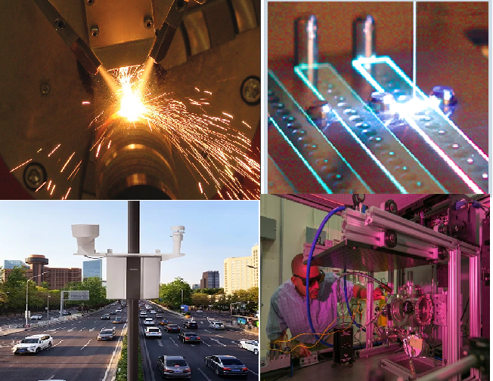
Industry applications

Slide 58
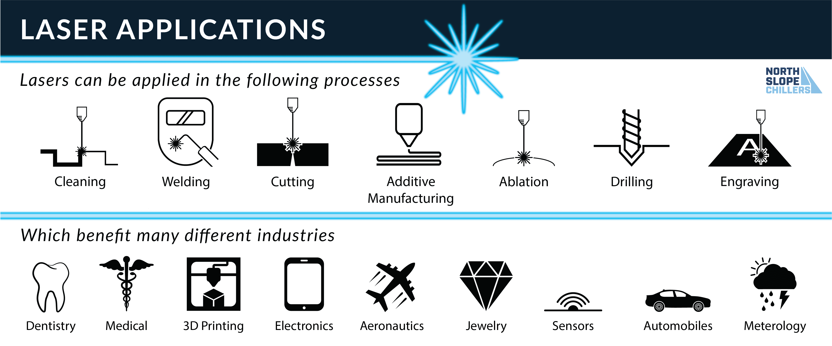

Slide 59
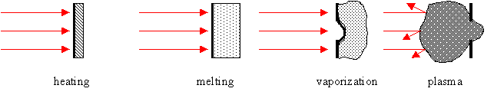

Slide 60
Welding: CO2 lasers are used in welding thin sheets and foils.
Drilling: can be dons by short duration. 10^-4 to 10^ -3 sec. (Ex.holes in a baby bottle and holes in diamond)
Heat treatment for Hardening: Used in automotive industry to strengthen cylinder blocks, gears, camshafts etc.CO2 laser of 1 kW is used for this application.
Cutting: The materials paper, wood, cloth, glass, quartz, ceramics, steel etc. Cutting is fine and precise. It does not introduce any contamination.

Slide 61
Holography: recording and reproducing an image (3D) without using lenses. 3D photography, microscopy, etc.
Electronics industry: lasers are used in the manufacture of the electronics components and integrated circuits such as trimming of thick and thin film resistors using lasers is a common application.
Measurement of atmospheric pollutants: Measurement of the concentrations of various pollutants such as N2, CO, SO2 etc gases and particulate matter dust, smoke and fly ash. It is used to determine the pollutants present in the air without sample collection or chemical processing.

Slide 62
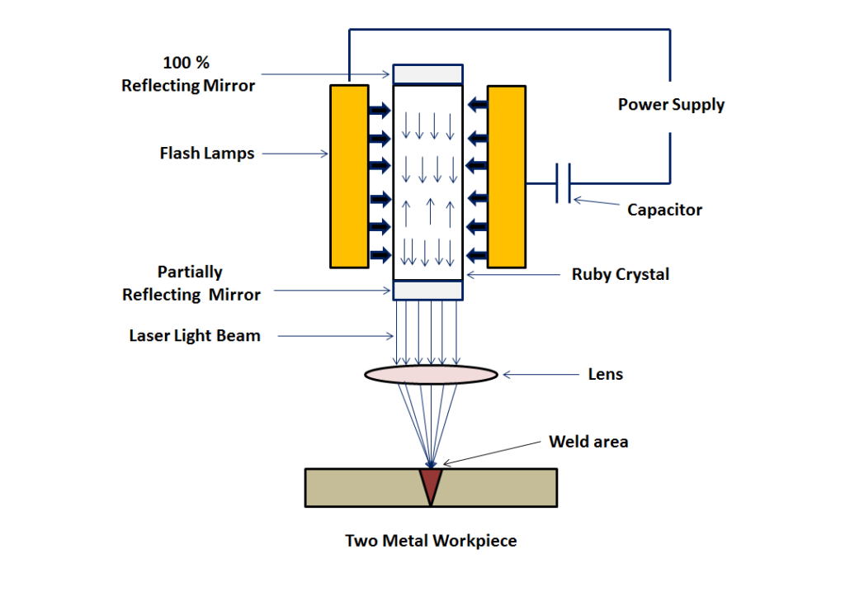
Welding

Slide 63
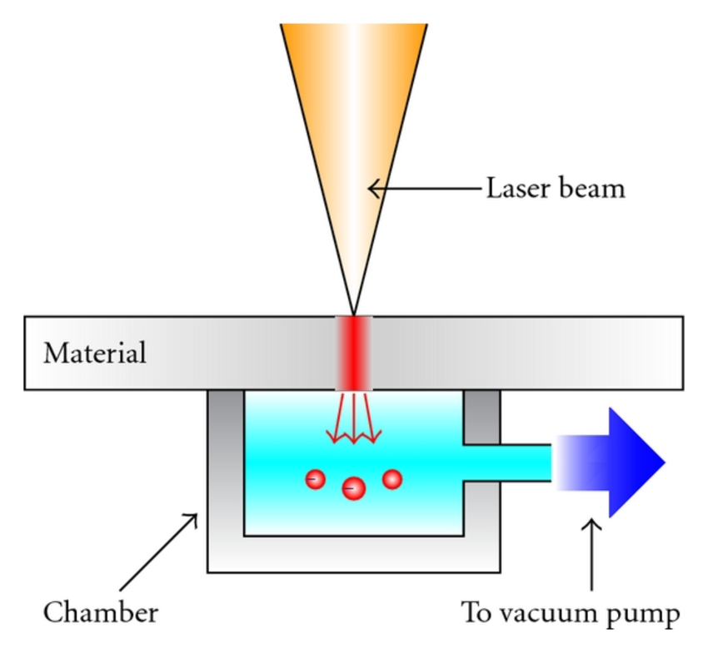
cutting

Slide 64
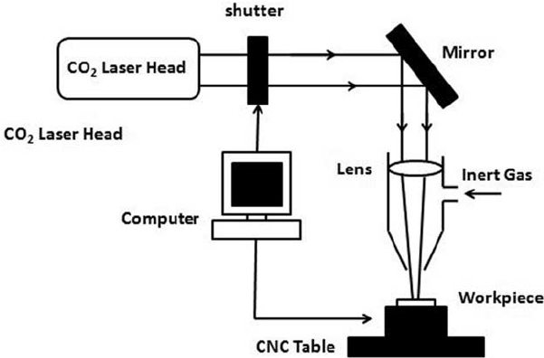
Drilling

Slide 65
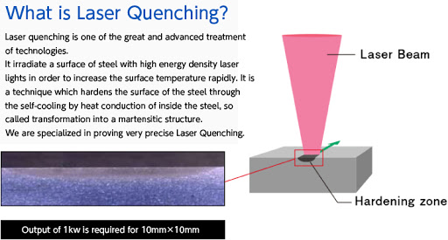
Heat treatment for hardening

Slide 66
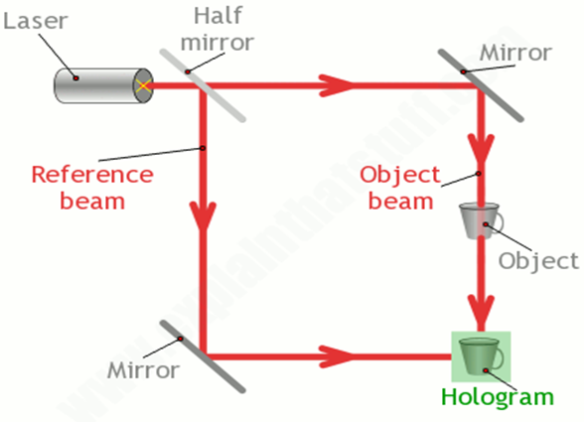
holography

Slide 67
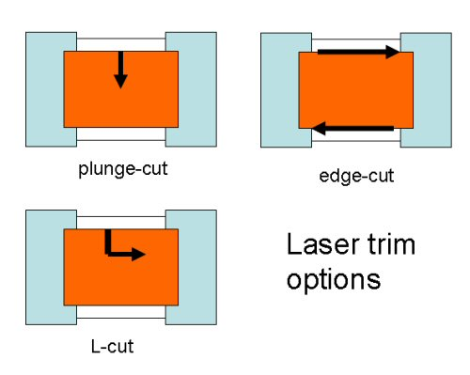
Electronics industry

Slide 68
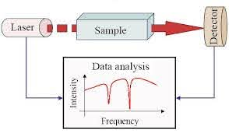
Measurement of pollutants in air

Slide 69
Lasers in Communications
Laser light is used in optical fiber communications to send information over large distances with low loss.
Laser light is used in underwater communication networks.
Lasers are used in space communication, radars and satellites

Slide 70
Lasers in Science and Technology
A laser helps in studying the Brownian motion of particles.
With the help of a helium-neon laser, it was proved that the velocity of light is same in all directions.
With the help of a laser, it is possible to count the number of atoms in a substance.
Lasers are used in computers to retrieve stored information from a Compact Disc (CD).
Lasers are used to store large amount of information or data in CD-ROM.
Lasers are used to measure the pollutant gases and other contaminants of the atmosphere.

Slide 71
Lasers in Science and Technology
Lasers helps in determining the rate of rotation of the earth accurately.
Lasers are used in computer printers.
Lasers are used for producing three-dimensional pictures in space without the use of lens.
Lasers are used for detecting earthquakes and underwater nuclear blasts.
A gallium arsenide diode laser can be used to setup an invisible fence to protect an area.

Slide 72
Laser in computer memory devices
Data storage is another area where higher density of storage is possible by using optical methods. The storage medium is generally a thin film of metal whose optical property, such as reflectivity, gets modified when illuminated with a powerful ‘WRITE’ laser. The lower power ‘READ’ laser reads the change in optical property as the information required.
It takes less than one square micron to record one bit of information. Laser video discs (LVD) are widely used as a source of entertainment. Though the laser optical data storage disc possesses high storage capacity over the magnetic disc yet it is not possible to erase the information written from optical data d

Slide 73
Lasers in Military
Laser range finders are used to determine the distance to an object.
The ring laser gyroscope is used for sensing and measuring very small angle of rotation of the moving objects.
Lasers can be used as a secretive illuminators for reconnaissance during night with high precision.
Lasers are used to dispose the energy of a warhead by damaging the missile.
Laser light is used in LIDAR’s to accurately measure the distance to an object.

Slide 74
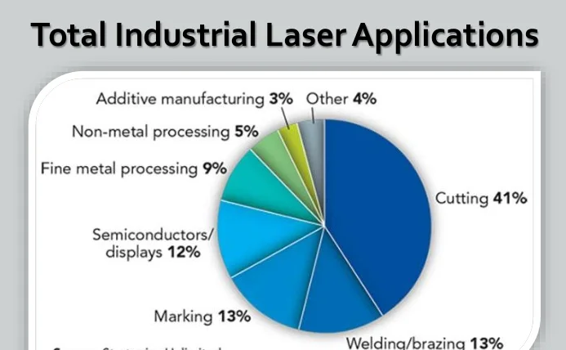
LASER in various Industry Applications in percentage

Slide 75
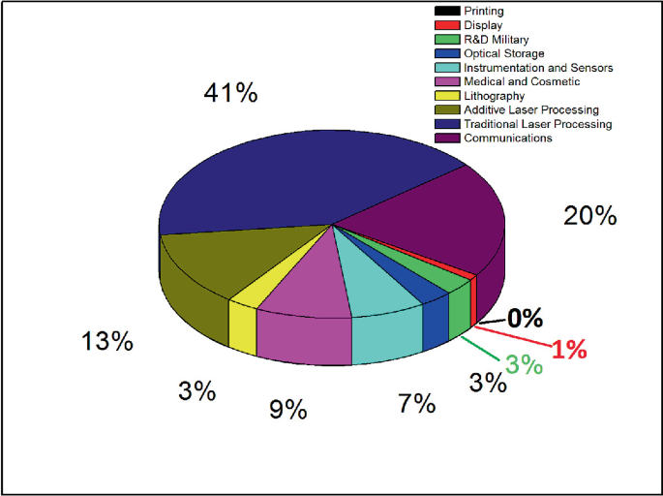
Total applications of Laser

Slide 76
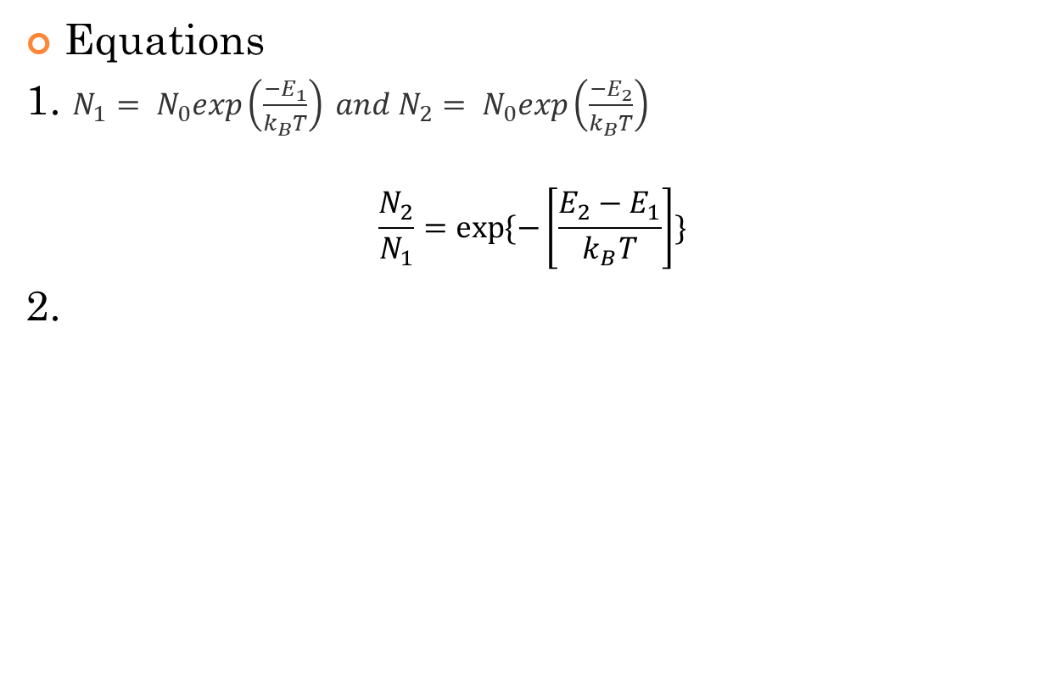
Possible problems in Laser Physics

Slide 77
Problems
Calculate the wavelength of emission from GaAs diode laser, if the bandgap of GaAs 1.44 eV. (λ=?)
The InGaAsP diode laser has peak emission wavelength of 1.55 μm. Determine its energy band gap. (Eg=?)
Find the ration of populations of the two states in a He-Ne laser that produces light of wavelength 6328 Å at 27º C. (N2/N1=?)

Slide 79
THANK YOU

